Slide 1
THROUGH YOUR EYES!
Rod Thom

Slide 2
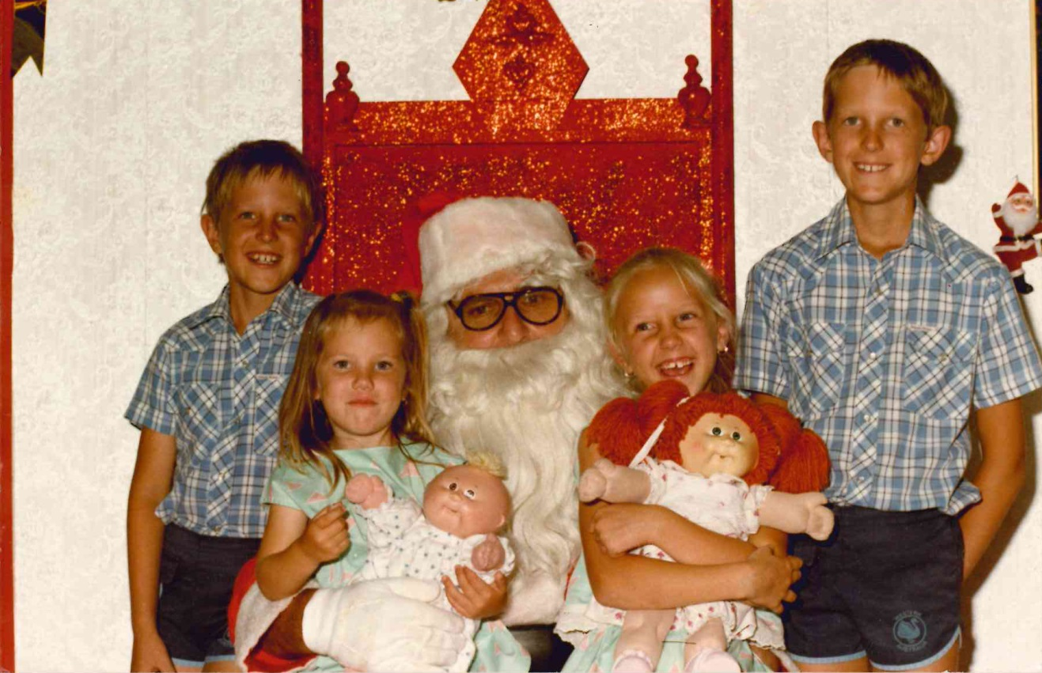

Slide 3
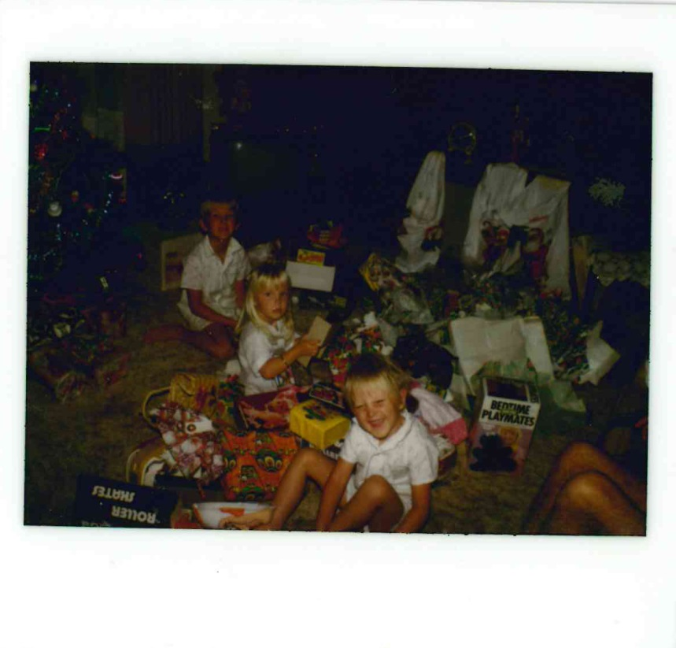

Slide 4
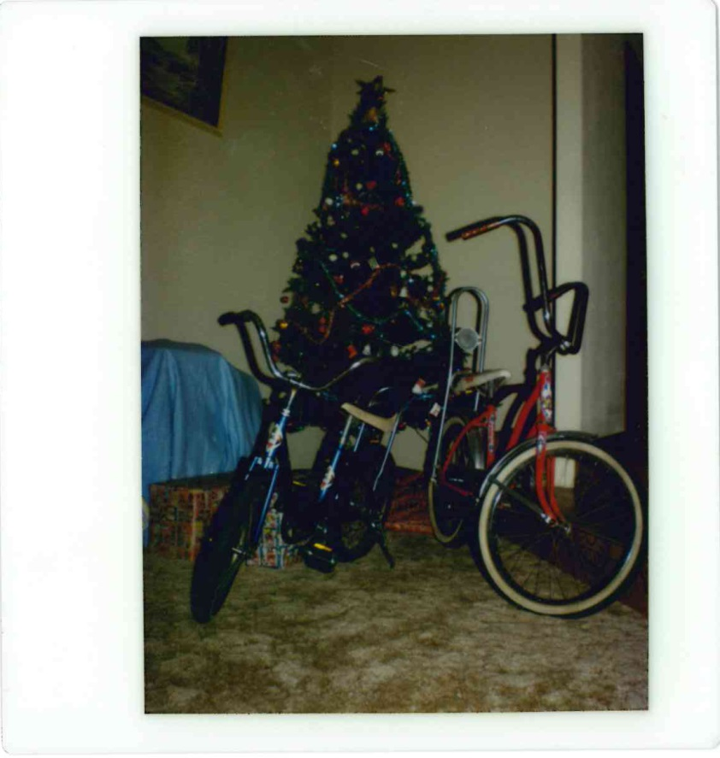

Slide 6
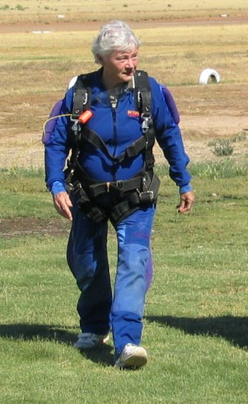
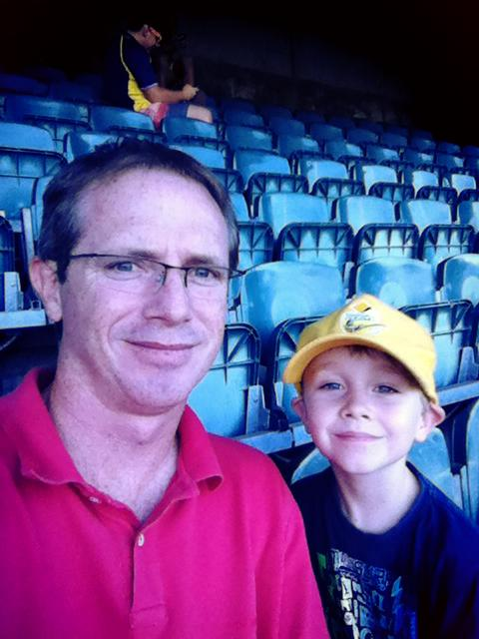
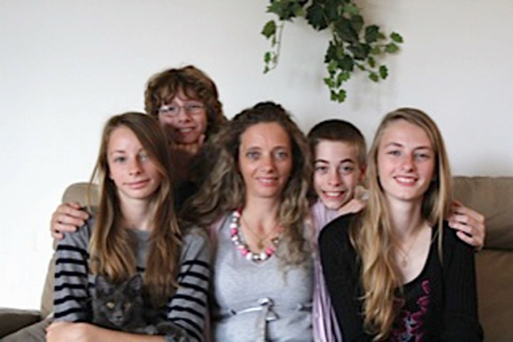
Barbara Mellor
Malcolm Cowell
Pomeline Decottignies

Slide 7
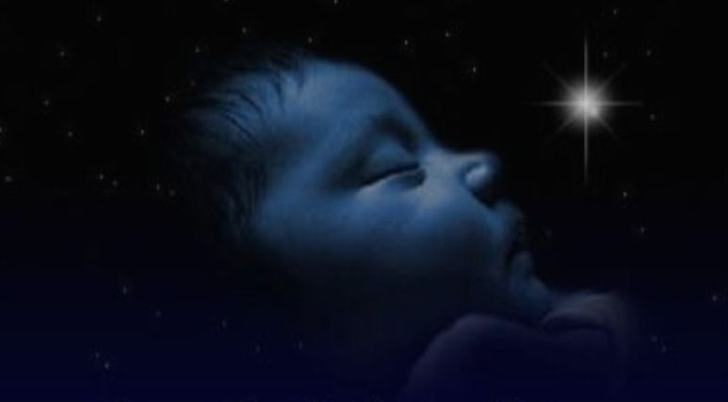
Isaiah 9:6-7 (MSG)
For a child has been born—for us!
the gift of a son—for us!
He’ll take over the running of the world.
His names will be:
Amazing Counselor,
Strong God,
Eternal Father,
Prince of Wholeness.

Slide 8
His ruling authority will grow, and there’ll be no limits to the wholeness he brings.
He’ll rule from the historic David throne over that promised kingdom.
He’ll put that kingdom on a firm footing and keep it going, With fair dealing and right living, beginning now and lasting always.
The zeal of GOD-of-the-Angel-Armies will do all this.

Slide 9
Isaiah 9:6-7 (MSG)
For a child has been born—for us!
the gift of a son—for us!

Slide 10
John 3:16 For God so loved the world that he gave his one and only Son, that whoever believes in him shall not perish but have eternal life. 17 For God did not send his Son into the world to condemn the world, but to save the world through him.

Slide 11
John 1:12: “Yet to all who received Him, to those who believed in His name, He gave the right to become children of God – children born not of natural descent, nor of human decision or a husband’s will, but born of God.”

